Slide 1
Auto Scaling Group

Slide 2
Content:
1. IAM Image (Custom AMI).
2. Create Custom AMI.
3. Elastic Load Balancing (ELB).
4. Auto Scaling Group.
5. ASG Architecture.
6. Network Load Balancer (NLB).
7. Steps to Create Auto Scaling Group.

Slide 3
1. IAM Image (Custom AMI)
In the context of AWS and cloud computing, a "Golden Image" typically refers to an Amazon Machine Image (AMI) that is meticulously configured and optimized to serve as a template for launching multiple instances.
Here are the key characteristics and uses of a Golden Image:
1. Highly Customized Configuration:
A Golden Image is pre-configured with specific settings, software installations, security configurations, and other customizations to meet the requirements of a particular application or workload.
2. Version Control and Maintenance:
It's important to manage and version control your Golden Images. Regularly updating and patching the image ensures that new instances launched from it have the latest security updates and software versions.
3.Quick and Efficient Deployment:
The purpose of a Golden Image is to expedite the process of deploying new instances with a predefined configuration. This is especially useful in environments where you need to scale up or down rapidly.

Slide 4
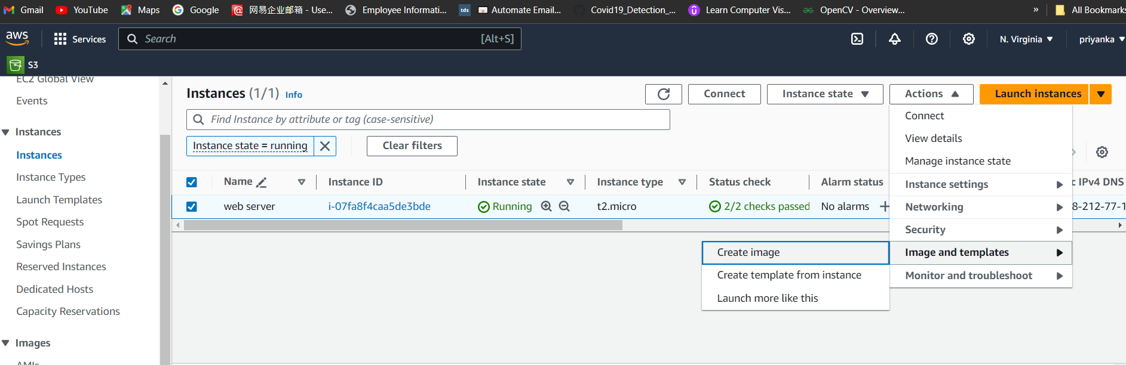
2. Create Custom AMI
Create ec2 instance and launch ec2 instance.
Install required Packages in your EC2 server.
sudo apt install git.
Sudo apt install apache2.
Select ec2 instance Actions-> Image and templates -> Create image.

Slide 5
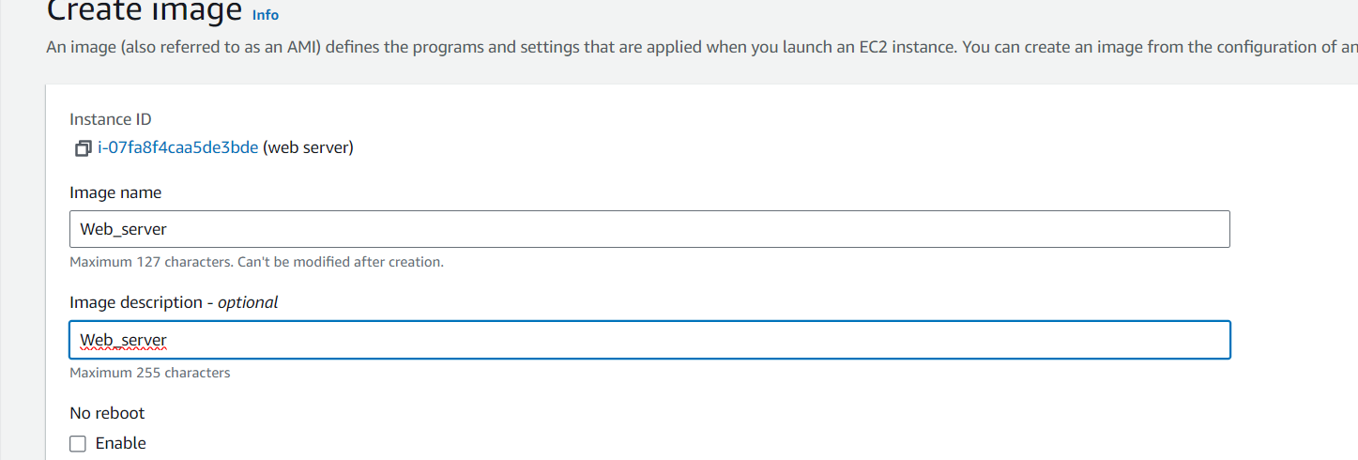
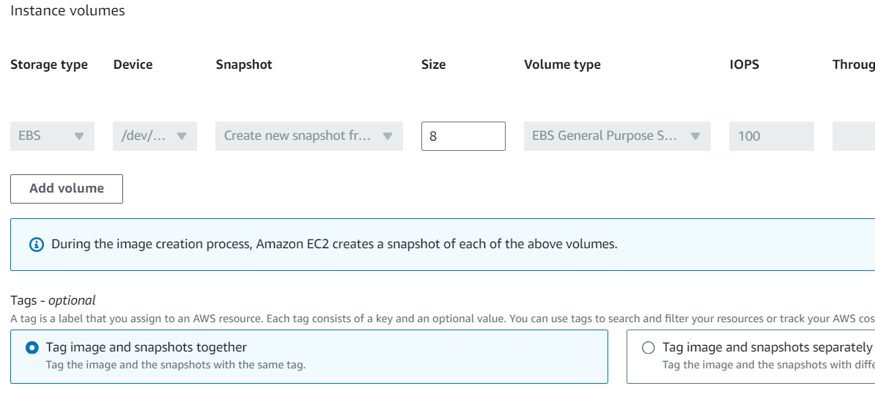
Give image name.
You will be allocated with the EBS volume with 8GB.
Click on create image.

Slide 6
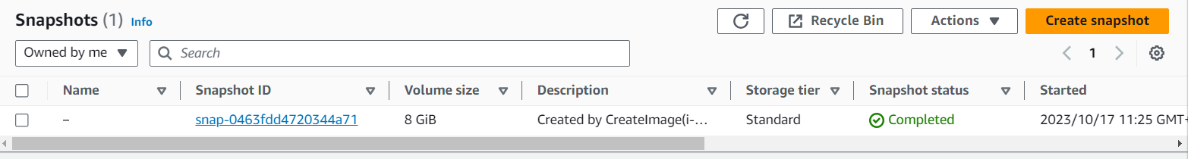
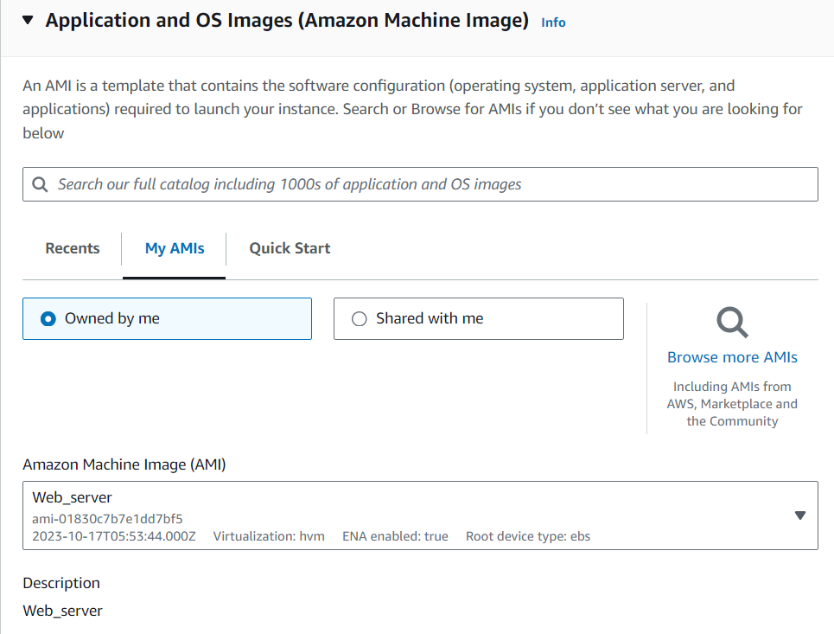
When you create the image it is called as golden image.
Now along with your Golden image automatically you will be allocated to the snapshots by default by aws.
Now, when you launch your new instance you can see that we can use our custom AMI.

Slide 7
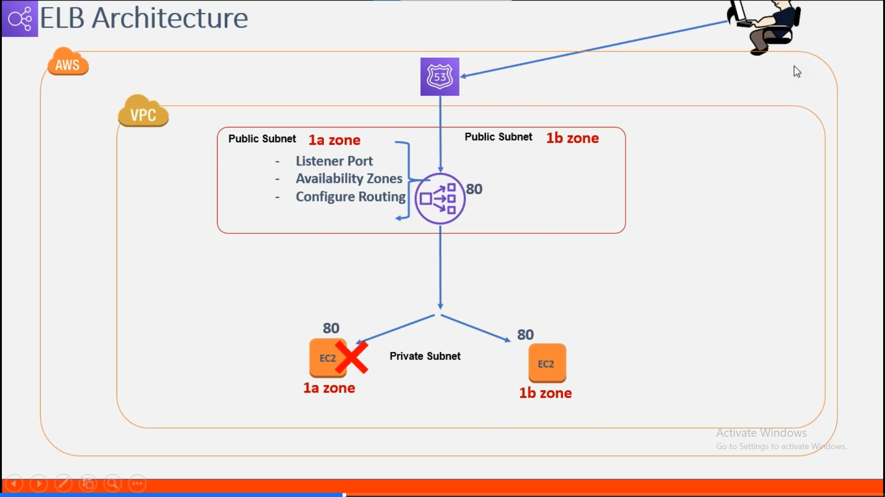
3. Elastic Load Balancing (ELB)
It is an AWS service that automatically distributes incoming application traffic across multiple targets, such as Amazon EC2 instances, containers, and IP addresses, in one or more Availability Zones. This helps ensure that your application can handle varying levels of traffic and improves availability.

Slide 8
Here are some key points about ELB:
Distribution of Incoming Traffic:
ELB distributes incoming traffic evenly across multiple instances or targets within a specified region.
Availability Zones:
ELB automatically routes traffic to healthy targets in different Availability Zones (AZs) to ensure high availability and fault tolerance.
Health Checks:
ELB regularly checks the health of its registered targets. If a target is considered unhealthy, it will stop sending traffic to it until it recovers.
Auto Scaling Integration:
ELB works seamlessly with Auto Scaling, allowing you to dynamically adjust the number of instances based on traffic patterns.
SSL/TLS Termination:
ELB can offload SSL/TLS decryption, reducing the processing burden on backend servers.
Path-Based and Host-Based Routing:
Application Load Balancer supports path-based and host-based routing, allowing you to direct traffic to different sets of targets based on the request path or host.

Slide 9
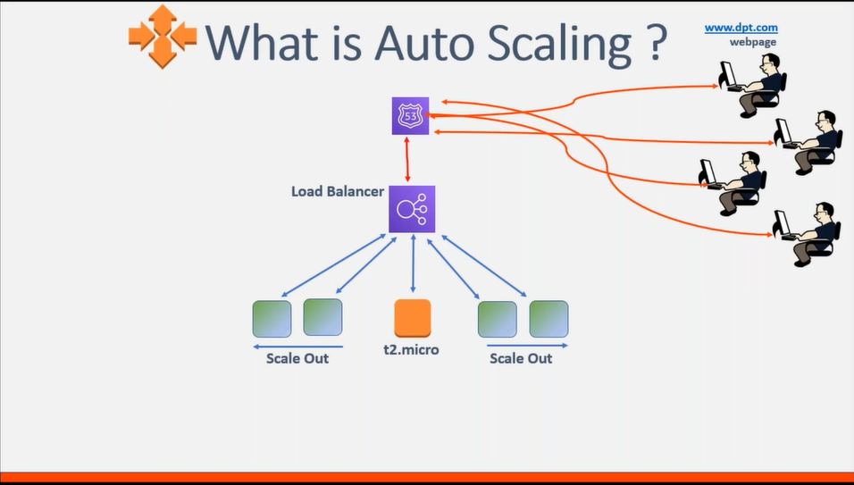
4. Auto Scaling Group
Auto Scaling is an AWS service that automatically adjusts the number of resources (such as Amazon EC2 instances) in your application's fleet based on real-time demand. This helps maintain a consistent and predictable performance while also optimizing costs.

Slide 10
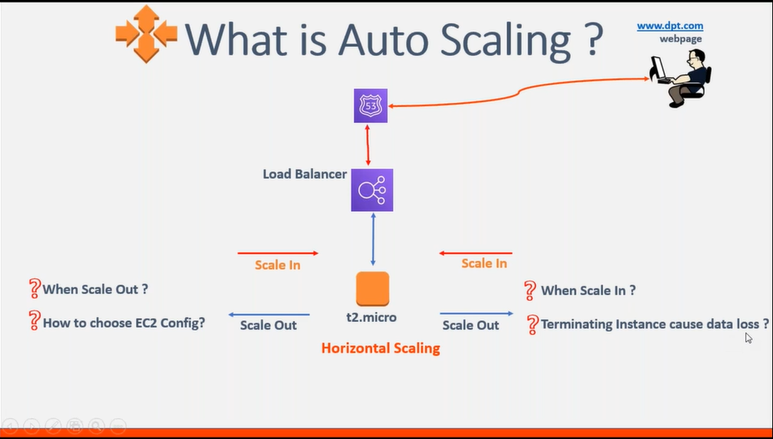
1. Scale In:
Definition: Scaling in (or down) involves decreasing the number of running instances in response to reduced demand or as a cost-saving measure.
When Does it Happen:
Auto Scaling may initiate a scale in operation when the average metrics (e.g., CPU utilization, request count) fall below a certain threshold defined in the scaling policy.
Use Case:
Typically used during periods of low demand, such as late at night or during weekends, to save costs. It's also employed when traffic patterns return to normal after a spike.
Result:
Instances are terminated, reducing the number of active instances in the Auto Scaling group.

Slide 11
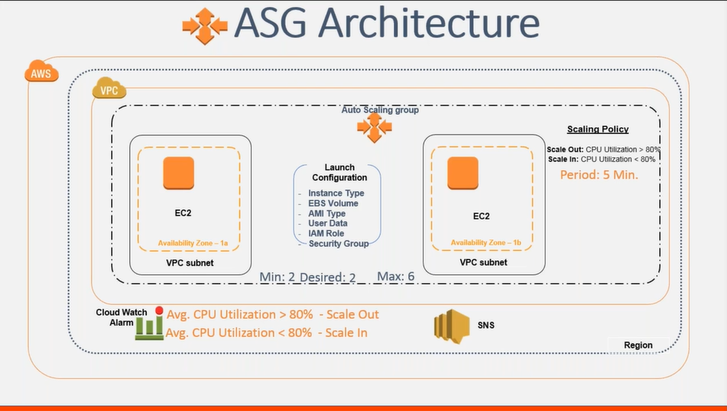
5.ASG Architecture

Slide 12
6. Network Load Balancer (NLB)
Network Load Balancer (NLB) is an AWS service that distributes incoming network traffic across a group of Amazon EC2 instances or IP targets. It operates at the transport layer (Layer 4) of the OSI model, meaning it routes traffic based on IP protocol data units (IP packets) and can handle high levels of traffic with extremely low latency.
Here are some key points about Network Load Balancer (NLB):
Layer 4 Load Balancer:
NLB operates at the transport layer (Layer 4) of the OSI model. It routes traffic based on IP protocol data units (IP packets).
Target Types:
NLB supports routing traffic to both Amazon EC2 instances and IP addresses.
Performance:
NLB is designed to handle extremely high levels of traffic and millions of requests per second. It is well-suited for applications that require high performance and low latency.

Slide 13
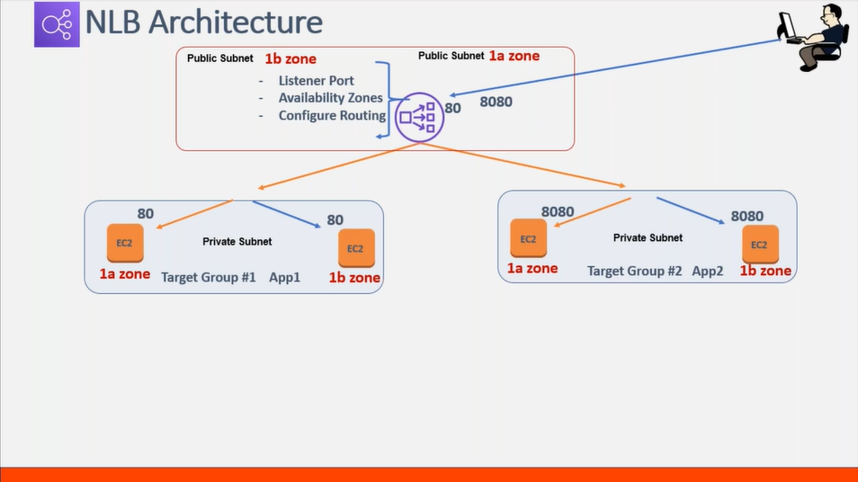

Slide 14
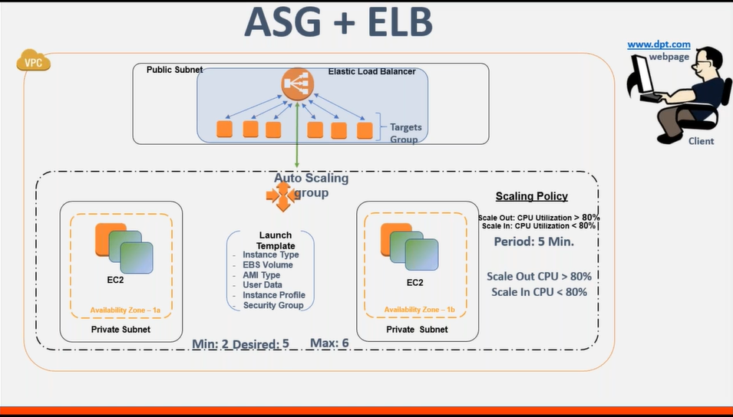

Slide 15
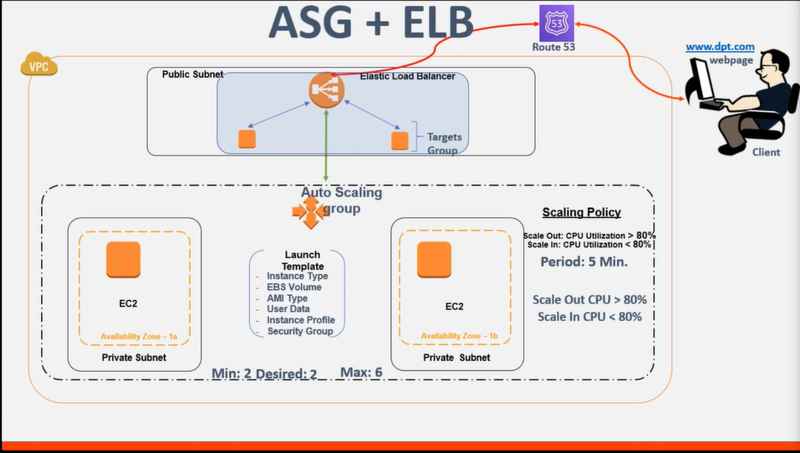

Slide 16
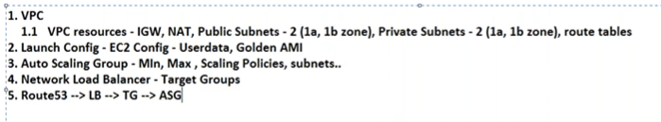
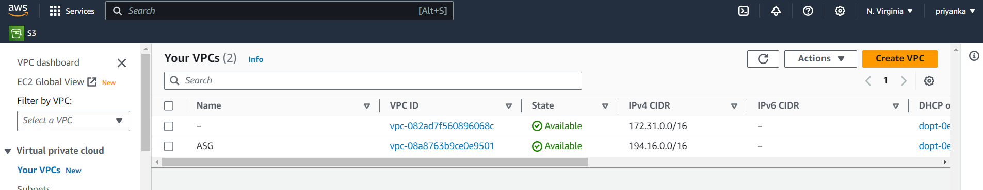
7. Steps to Create Auto Scaling Group
Required components to create ASG
Step 1: create VPC, here I have created vpc with the name “ASG”.
Now in vpc we need to create subnets, and route table.

Slide 17
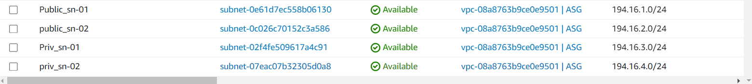
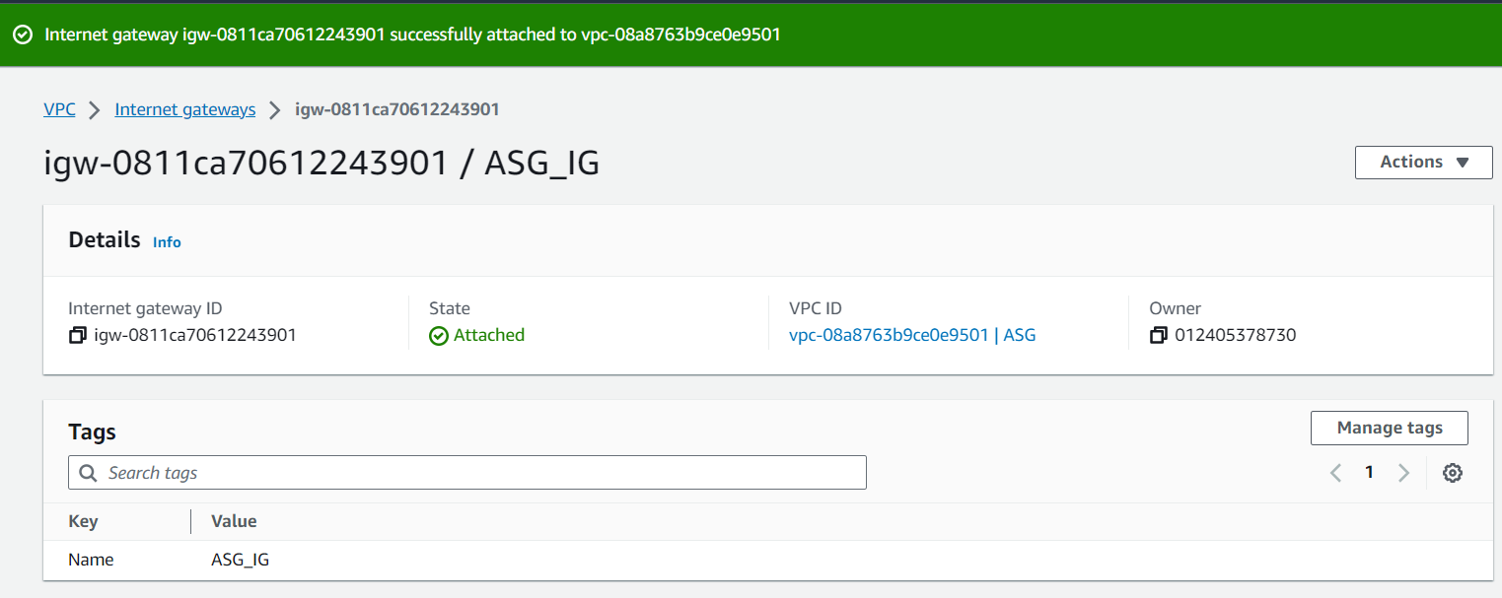
We have created 4 subnets where public_sn-01, Priv_sn-01 in “us-east-1a”, and public_sn-02, priv_sn-02 in “us-east-1b”zone.
Create Internet Gateway and attach it to the created VPC.

Slide 18
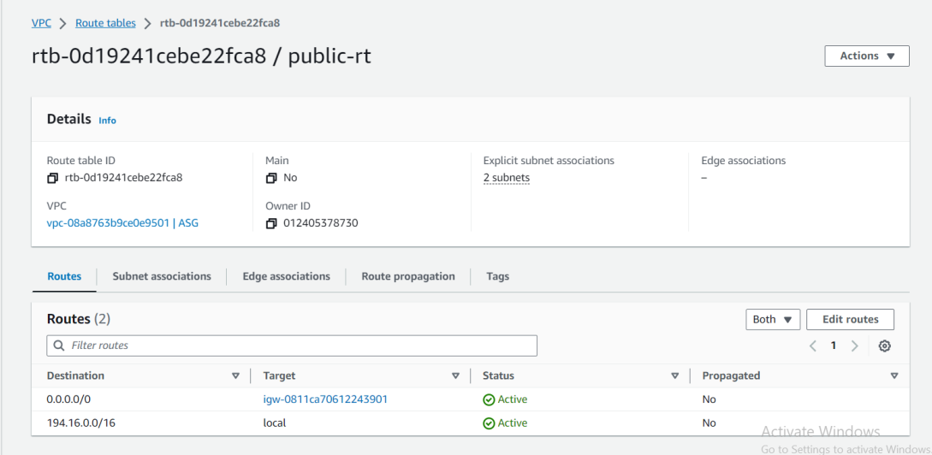
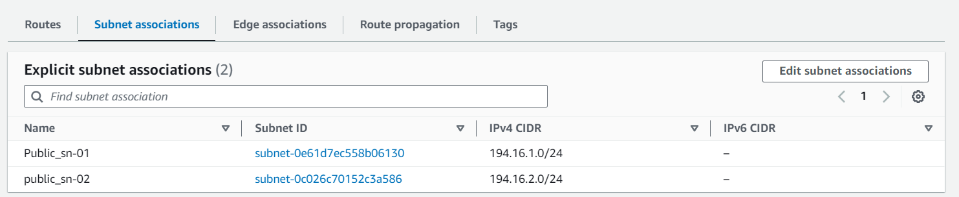
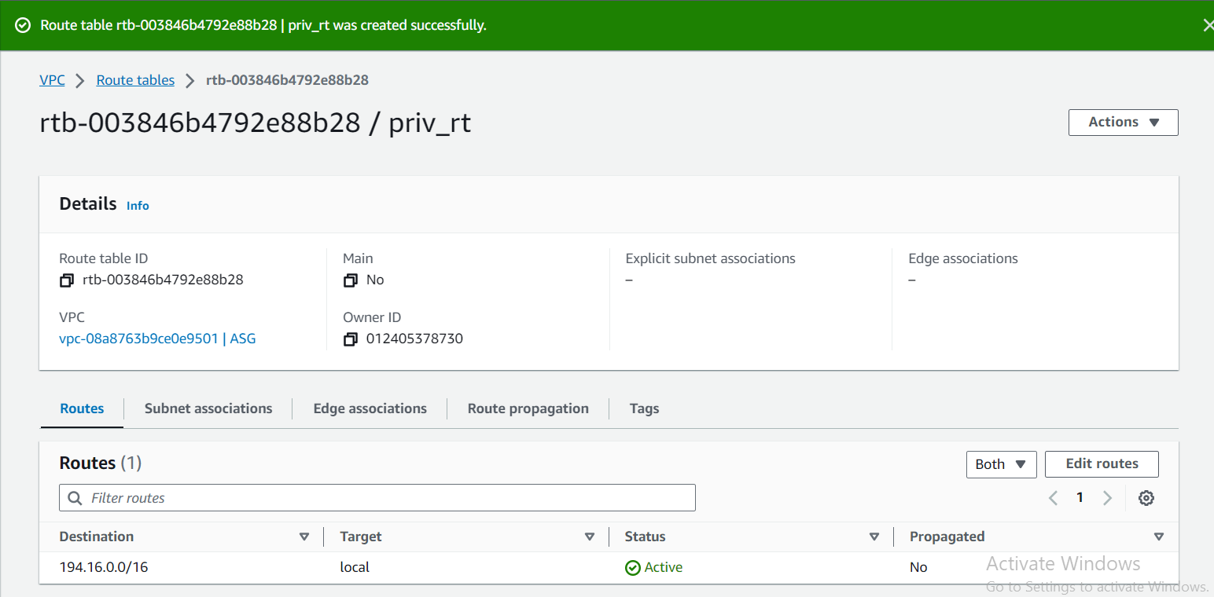
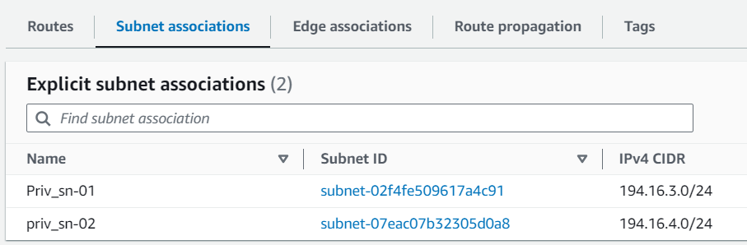
Create 2 route tables one for public, and one for private.
Created public-rt, subnets associated with public subnets, along with the local and internet gateway routes
. Created priv-rt, subnets associated with priv subnets, attached with only local gateway.

Slide 19
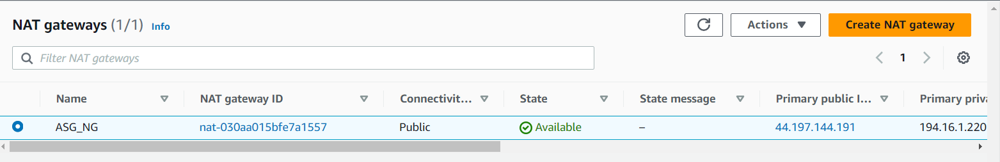
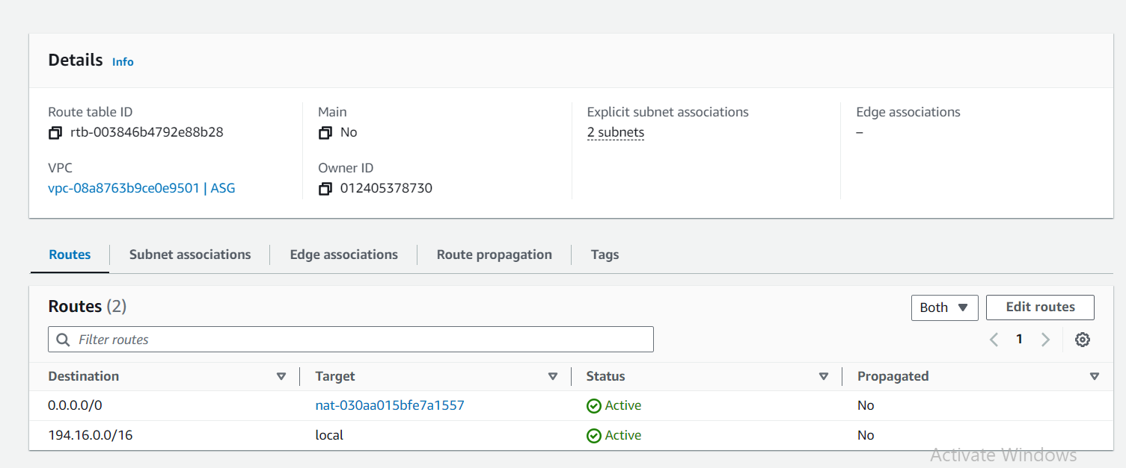
Create NAT Gateway with elastic ip.
Attach your nat gateway to your private route table.
Now your done with the 1st step of ASG.

Slide 20
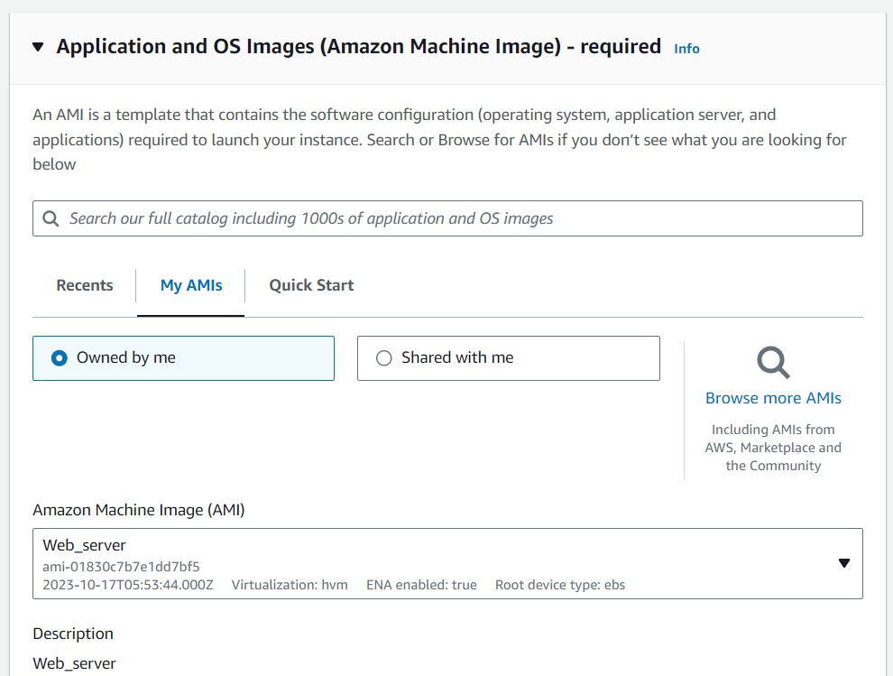
Step 2: create Image (Custom AMI)
As we have already created our custom AMI lets take it.

Slide 21
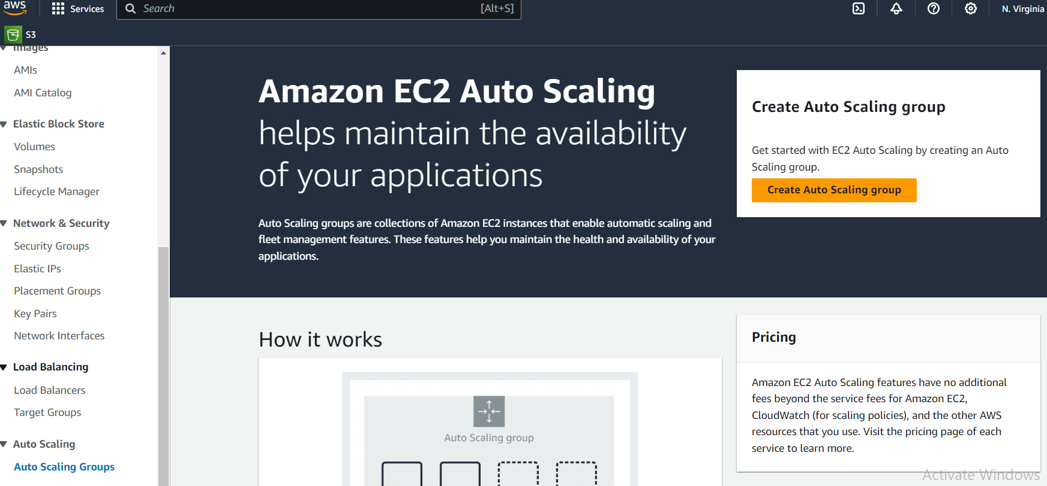
Step 3: Create Auto Scaling Group.
AWS > EC2> Auto Scaling > Auto Scaling Group >create Auto Scaling Group

Slide 22
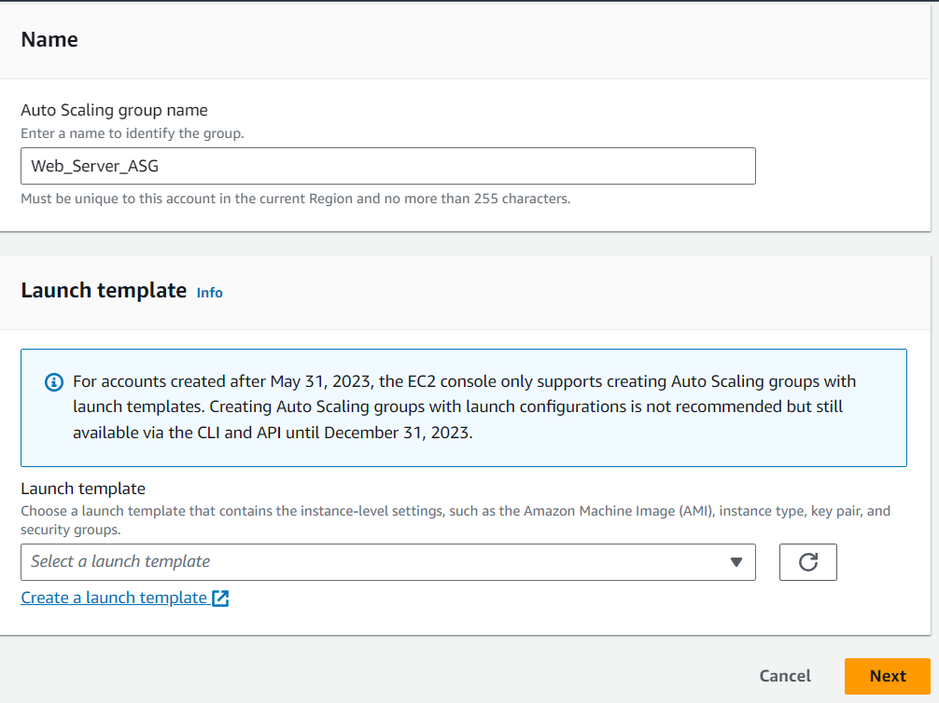
Give a name for your ASG name, and create Launch Template

Slide 23
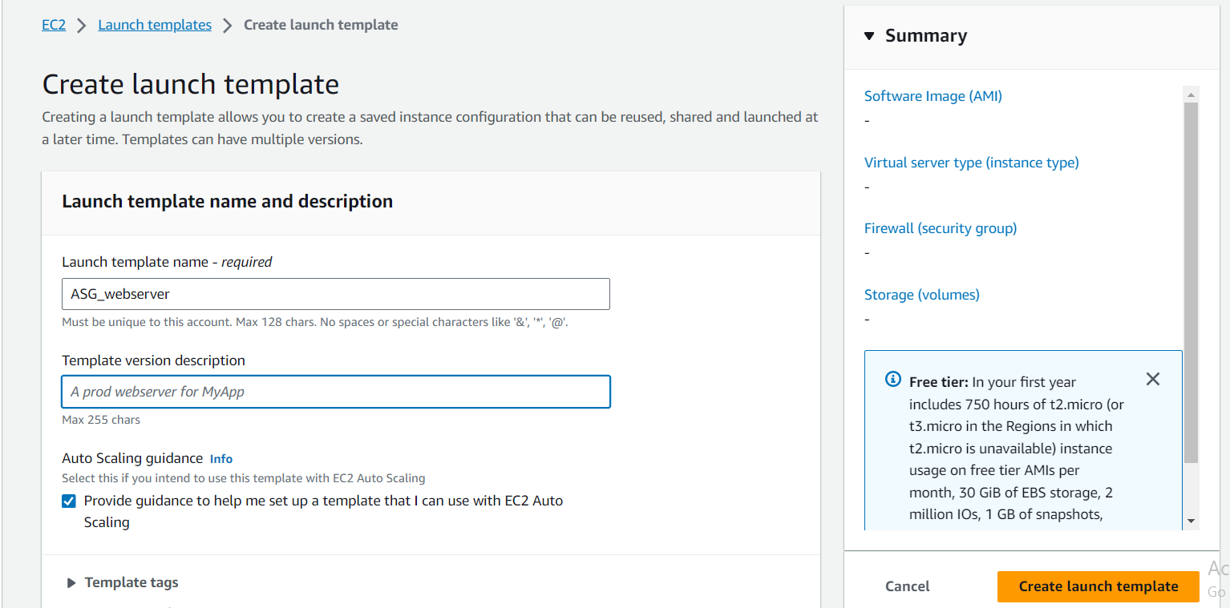
Give a template name.
Select the Golden AMI that we have created.

Slide 24
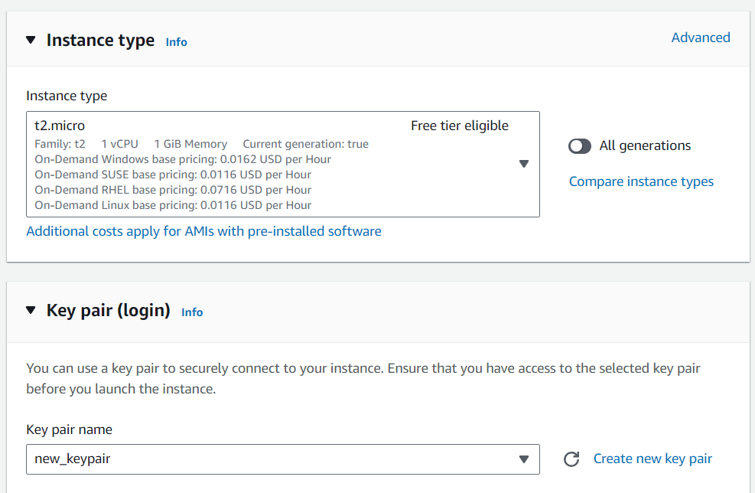
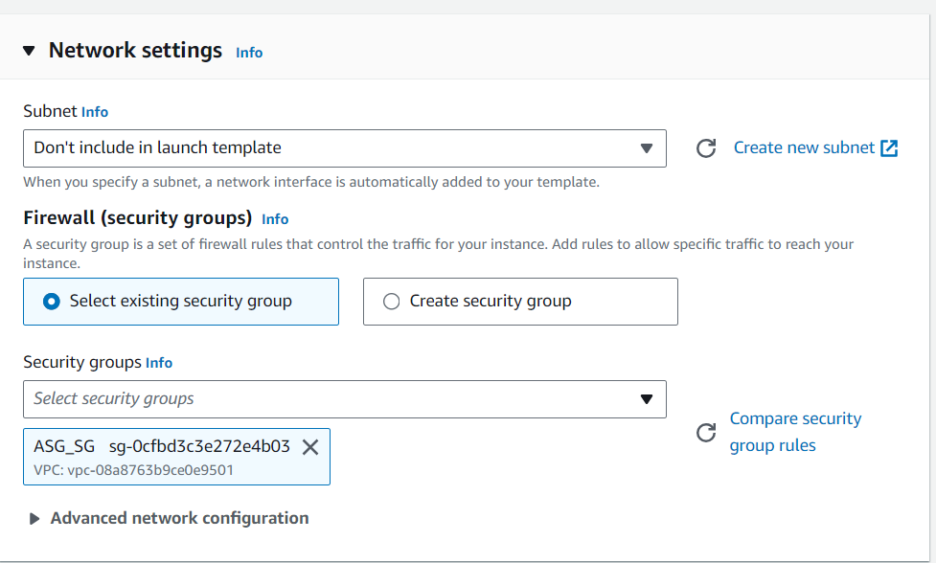
Select the Instance type and keypair.
Select the Security Group.
Click on create launch template.
Your template is created.

Slide 25
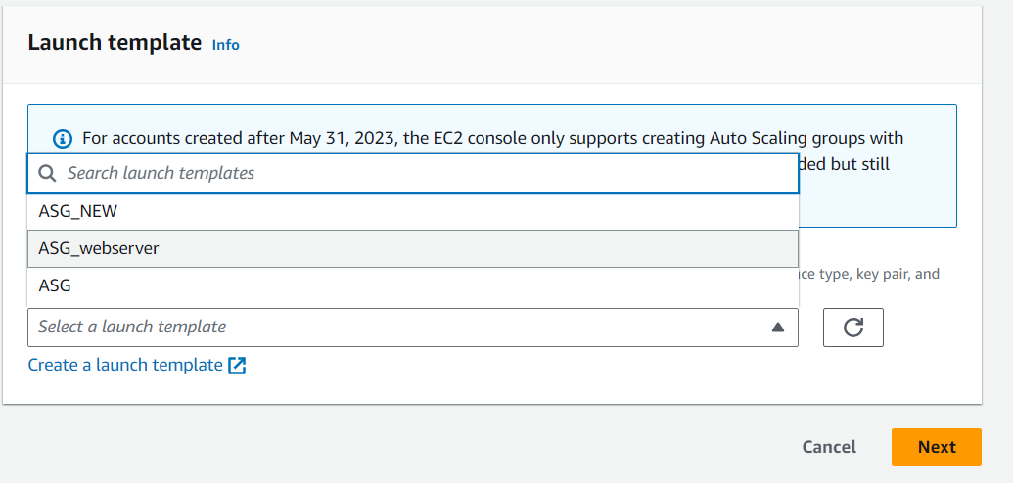
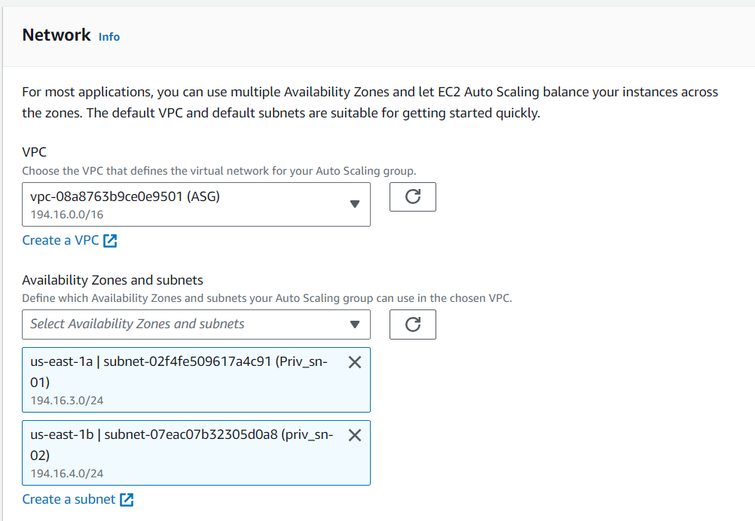
Now come back to the ASG creation, and select the template that we have created.
Select your VPC and Private subnets. Click on next.

Slide 26
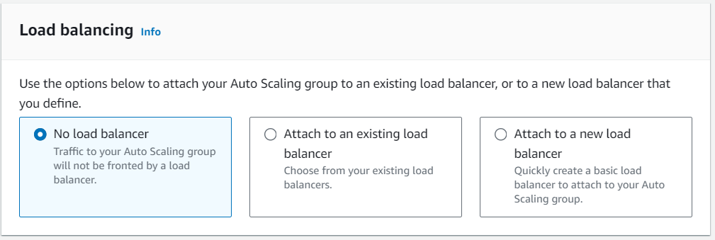
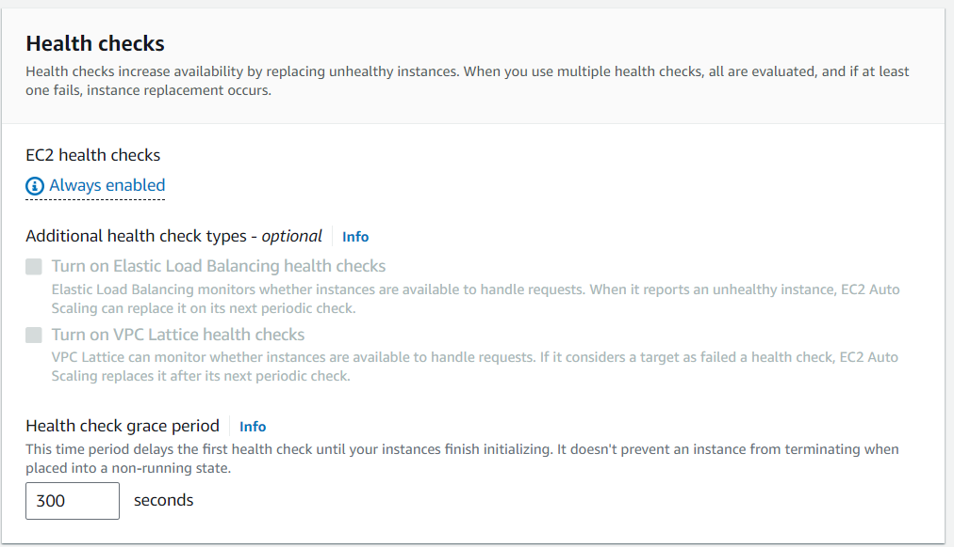
As of now as we have not created load balancer yet, so lets select no load balancer.
Health Checks are used to check the instance after every period of time to verify whether the instance is upend running with the 2/2 check status.

Slide 27
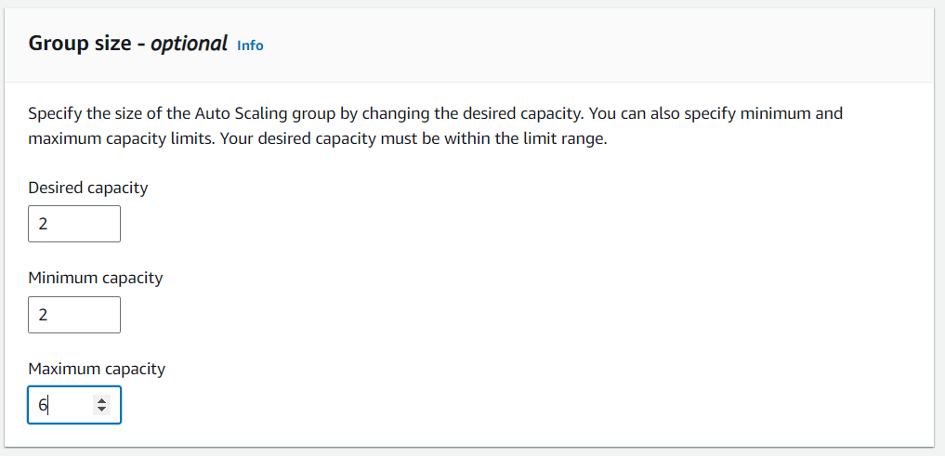
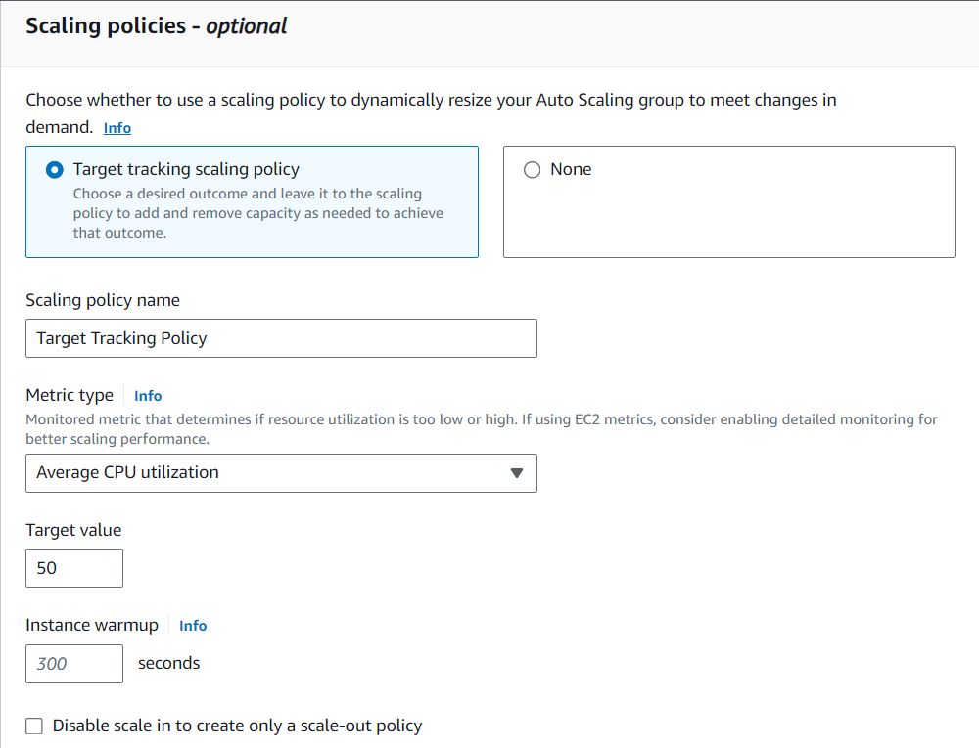
Give the proper min and max number of scale out and scale in according to your requirement.
Attach Scale in Policy to your cpu utilization, with the threshold of 80%.

Slide 28
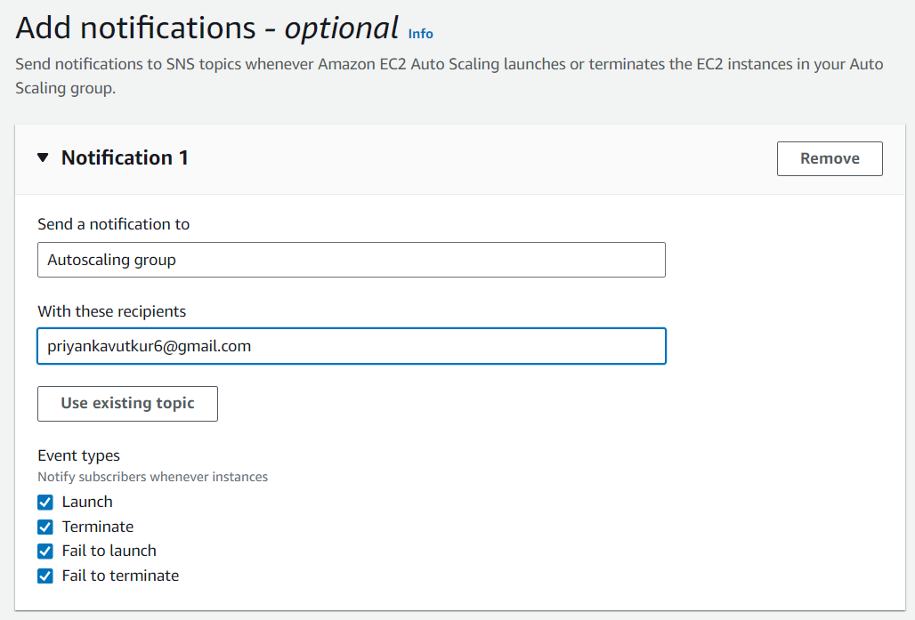
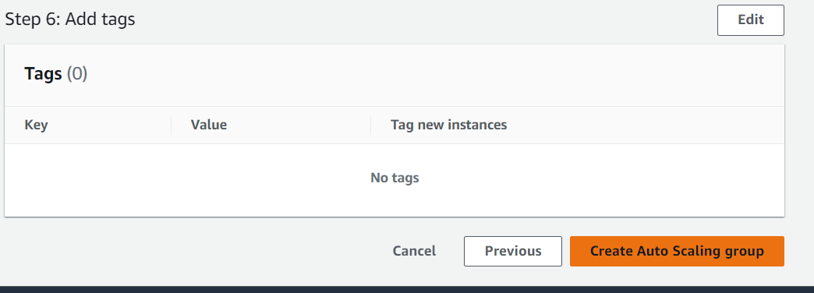
Add Notification through sns to get the updates of the Auto Scaling.
Click on create auto scaling group.

Slide 29
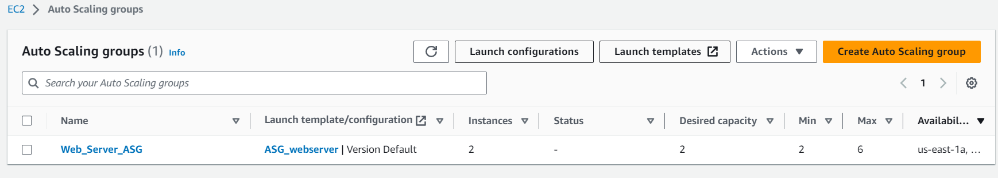
Now here you can see that we have successfully created the ASG.
Here ASG will create 2 instances automatically as we have given min instances are 2.
Lets check whether our ASG is working properly or no.
Let stop one of my instance. As we have given 2 min instances need to be present, on upend running. It has to create one more web server.

Slide 30
See I have stopped my web server ,ASG will create new web server.
This how ASG will crate new web server, when other server is down.
Now lets see how ASG will create new web server when cpu utilization is more then threshold.
This can be achieved using load balancing.
Lets create load balancing.

Slide 31
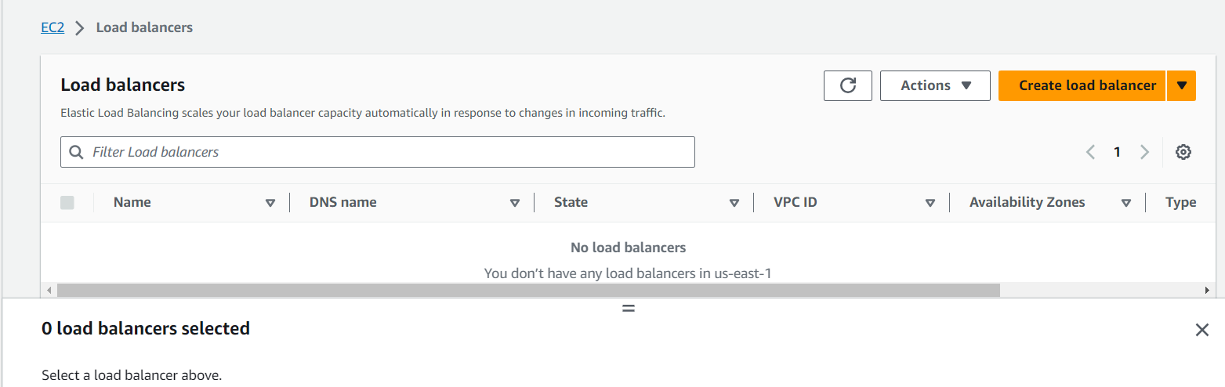
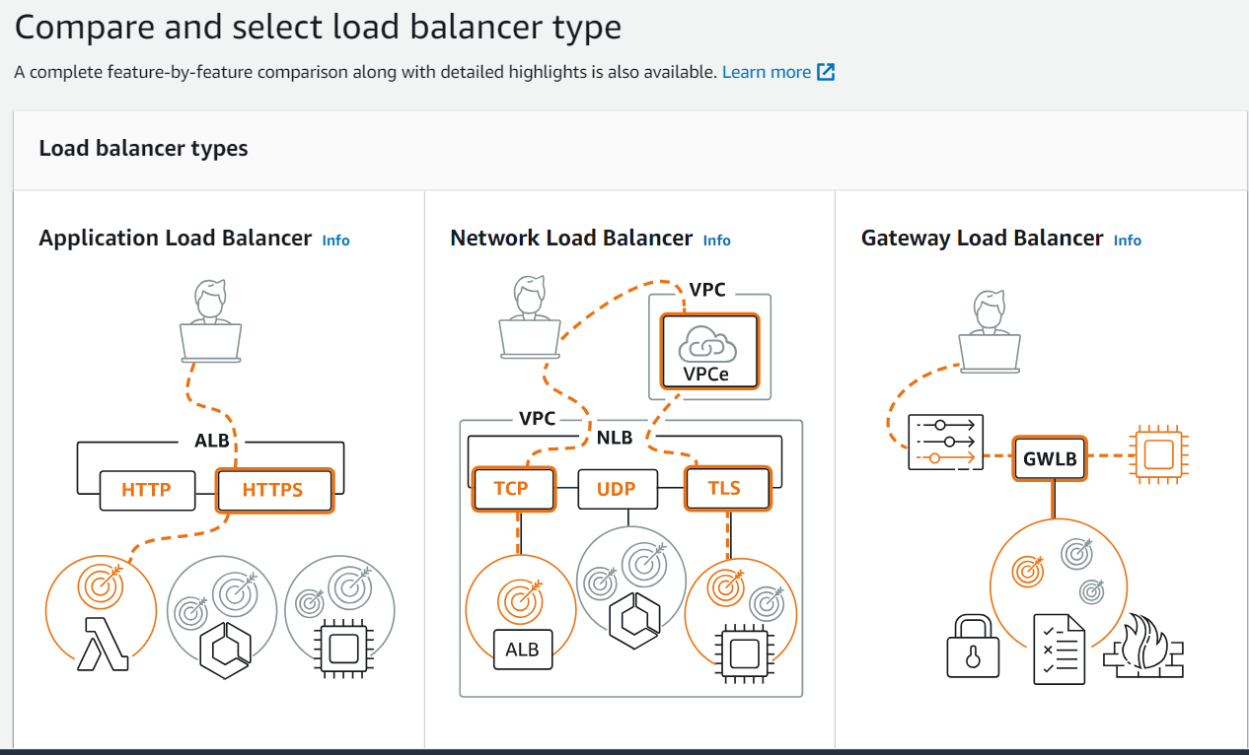
Step 4: Create Load balancer.
EC2> Load balancer.
Create Load Balancer.
Select network load balancer.

Slide 32
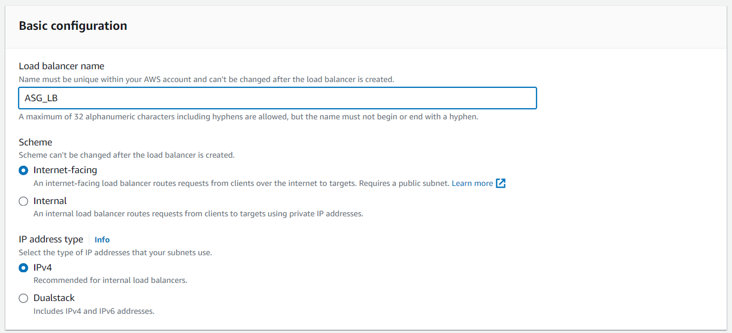
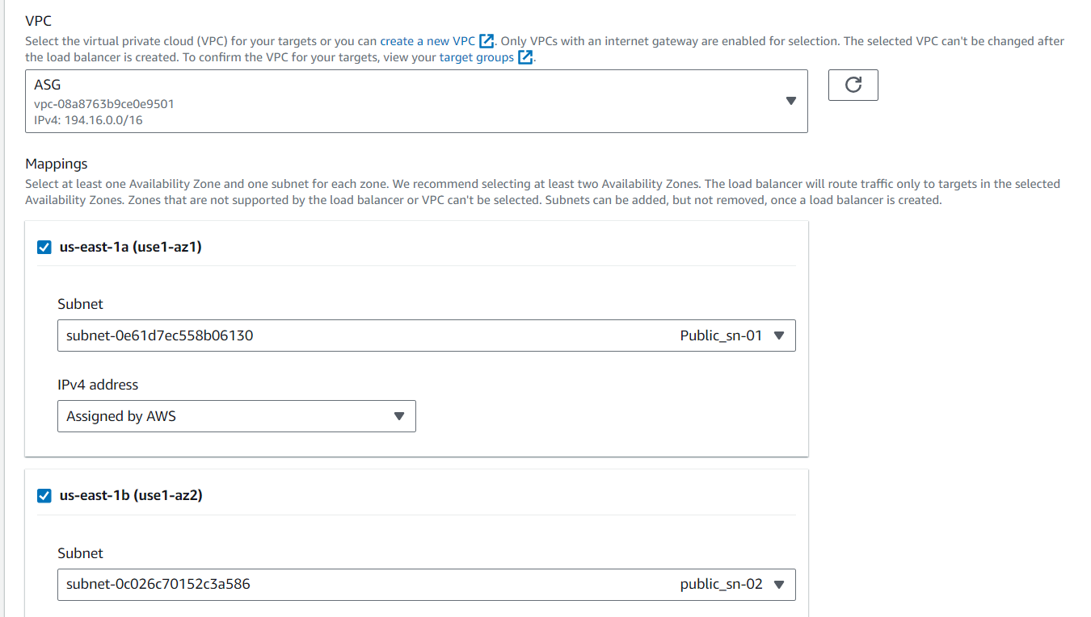
Give a Load Balancer name.
Select created VPC.
You need to select mapping for both the zones and assign Public subnets.

Slide 33
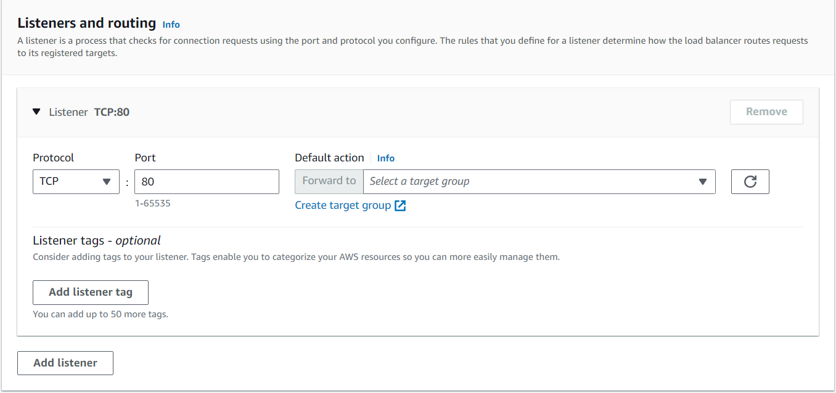
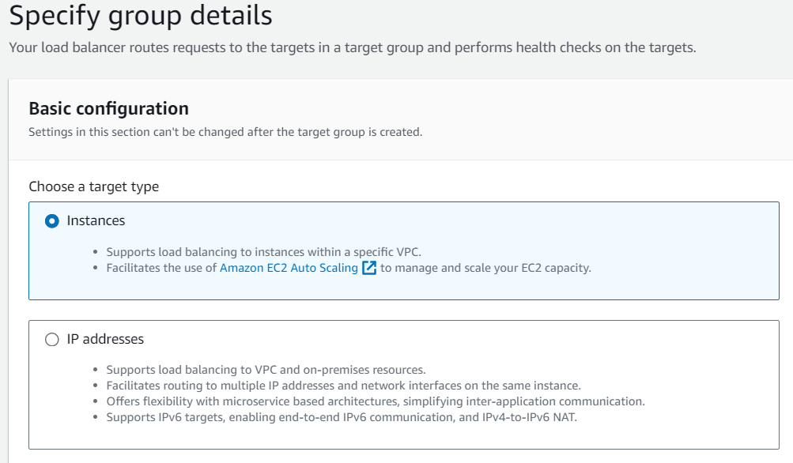
In Listeners and routing, create target group.
In target group select instances, as we are creating ec2 instance service.

Slide 34
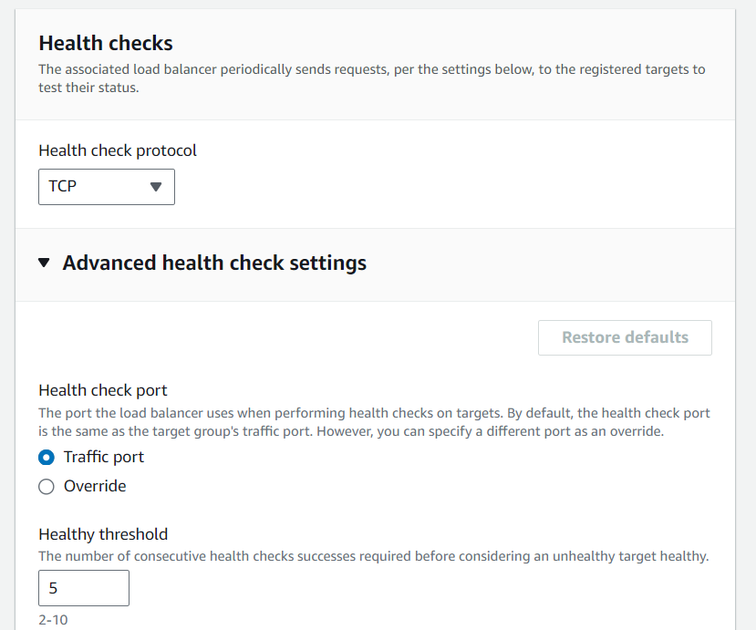
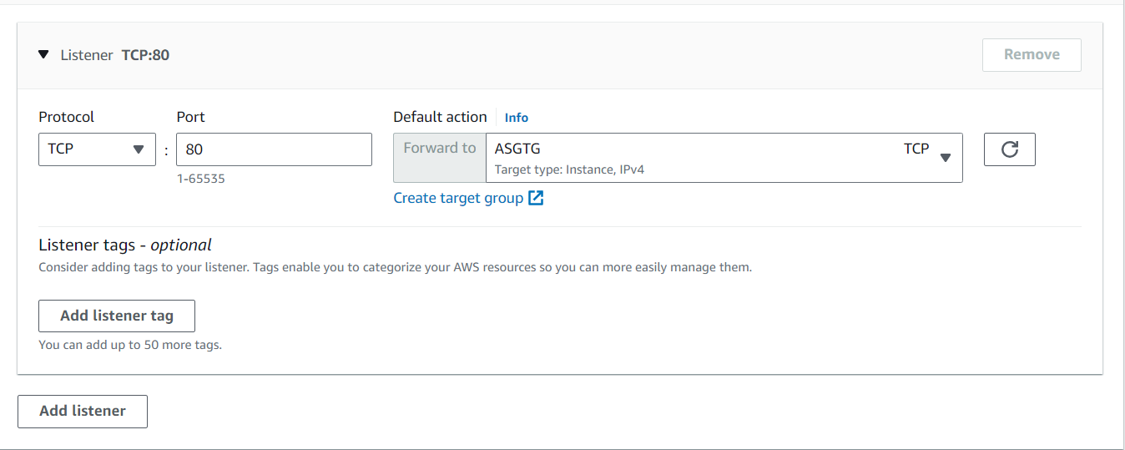
Select TCP Health check protocol, to check whether we are able to access our server.
Click Create Target Group.
Come back to the create load balancer and select the target group that we have created.
Create Load Balancer.

Slide 35
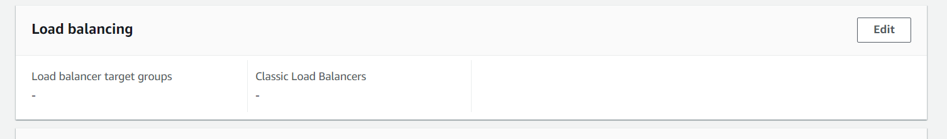
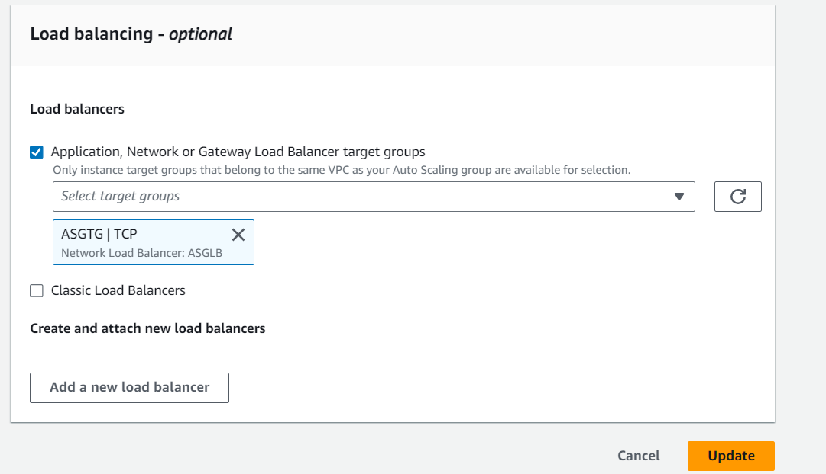
Add your load balancer to your ASG.
AWS >EC2> Auto Scaling Group> select your auto scaling group> load balancing > Edit
Select the Target group that we have created.
Update the Load balancing.

Slide 36
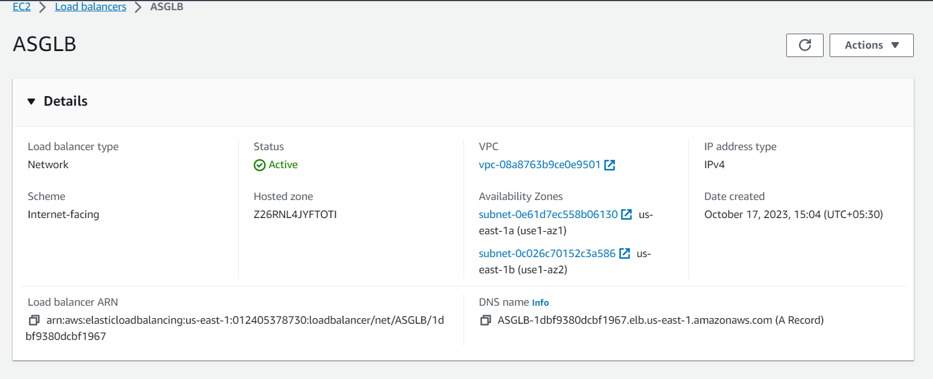
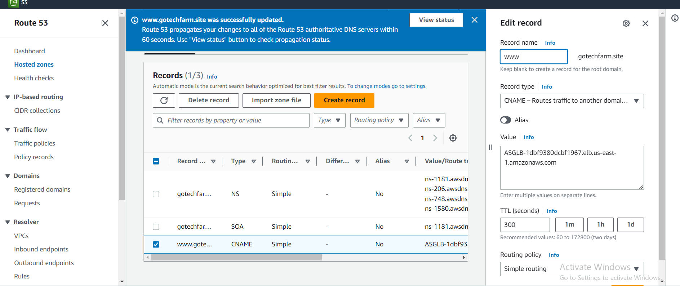
Now go to the load balancer and copy DNS to connect to the route 53.
To your custom DNS Create CNAME record and paste your copied DNS name in a value content.
You are successfully created with the Auto Scaling Group.
Now you can acess your web site using custom domain name.

